Slide 1





Sao Paulo, Brazil October 2014
Quantitative modelling of electron transport using DFT
Ivan Rungger, Maria Stamenova, Andrea Droghetti and Stefano Sanvito
School of Physics and CRANN, Trinity College Dublin, IRELAND
Notes:
1

Slide 2
Outline
Lecture 1: Practical introduction to quantum transport
Why is it important?
From simple models to NEGF
Inelastic scattering within NEGF
Lecture 2: Is DFT-transport predictive?
DFT based electron transport
Problems with DFT for transport through molecules
Master equation approach
Lecture 3: Solid state spin-electronics devices
Magnetoresistance in magnetic tunnel junctions
Spin transfer torque
Strong correlations: Kondo effect
Notes:
2
Mention: “is it predictive”: once we know all atomic positions, can we predict the transport properties?

Slide 3
Why magnetic tunnel junctions?
Notes:
3

Slide 4
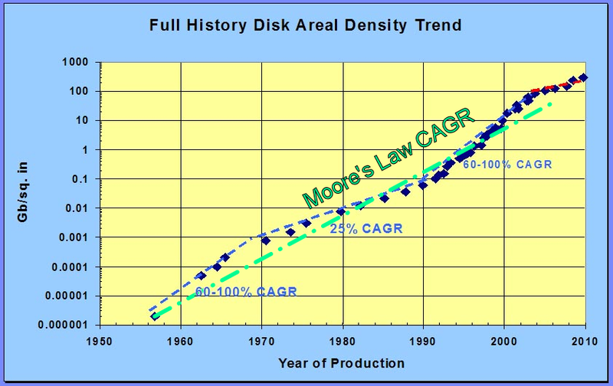
Why is it useful ?
From Wikipedia
Hard-disk technology

Slide 5
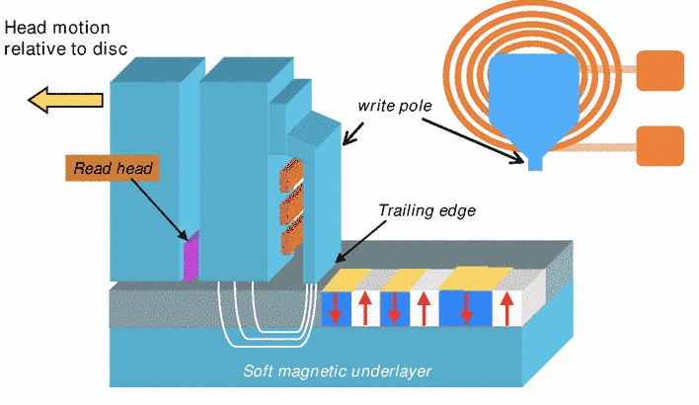
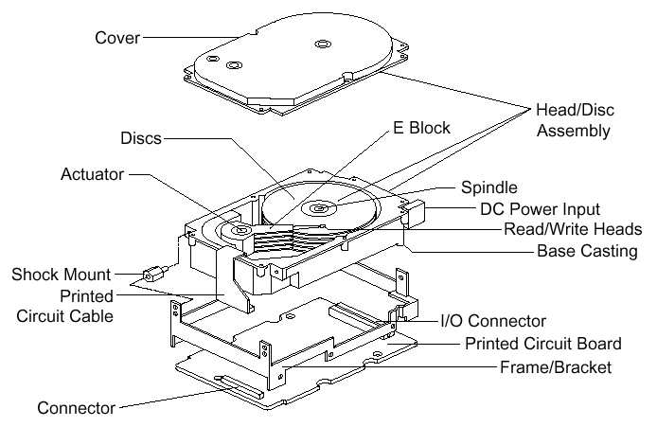

Slide 6
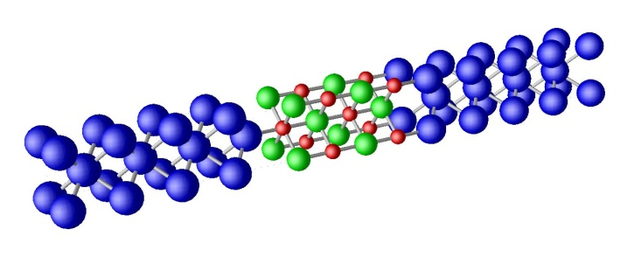
Magnetoresistance
Parallel
I
I
MR =
P
AP
I
AP
Anti-Parallel
Notes:
Mention that part of difference between theory and exp is due to defects

Slide 7
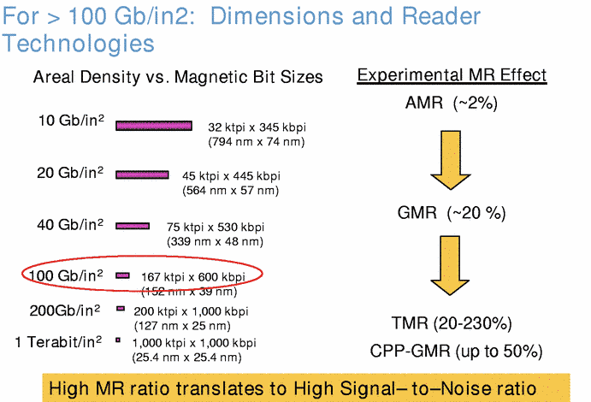

Slide 8
Simple theory of tunneling
Notes:
8

Slide 9
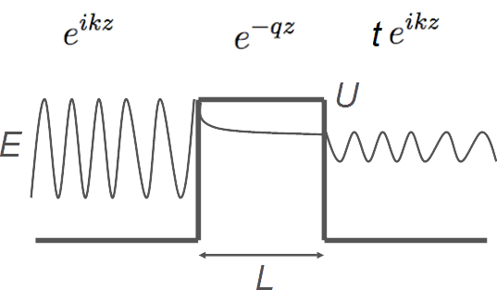
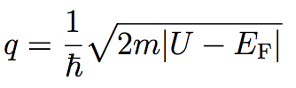
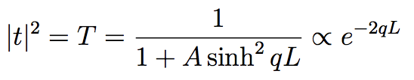
Basic tunneling

Slide 10
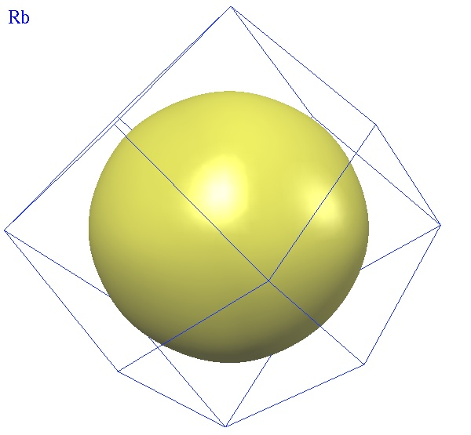
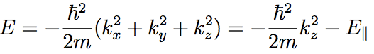
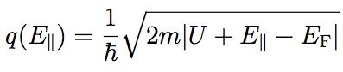
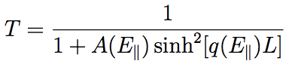
Translational invariance
k_{y}
k_{z}

Slide 11
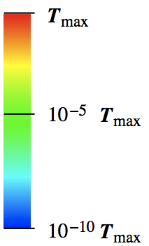

k_{x}-k_{y} dependent transmission
T small
k_{y}
k_{z}
k_{y}
k_{y}
k_{x}
T large
k_{z}
Notes:
11

Slide 12
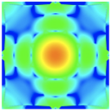
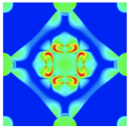
Spinpolarized electrodes: 2 spin-fluids model
DOS
E_{F}
Majority ↑
E
Minority ↓
Notes:
12

Slide 13
Fe/MgO/Fe tunnel junctions
Notes:
13

Slide 14
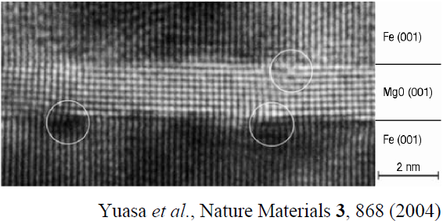
Tunneling magneto-resistance (TMR)
I
I
MR =
P
AP
S. S. P. Parkin et al., Nature Materials. 3, 862 (2004)
I
AP
Parallel
Theoretical prediction:
Anti-Parallel
W.H. Butler et al., PRB 63, 054416 (2001)
Notes:
Mention that part of difference between theory and exp is due to defects

Slide 15
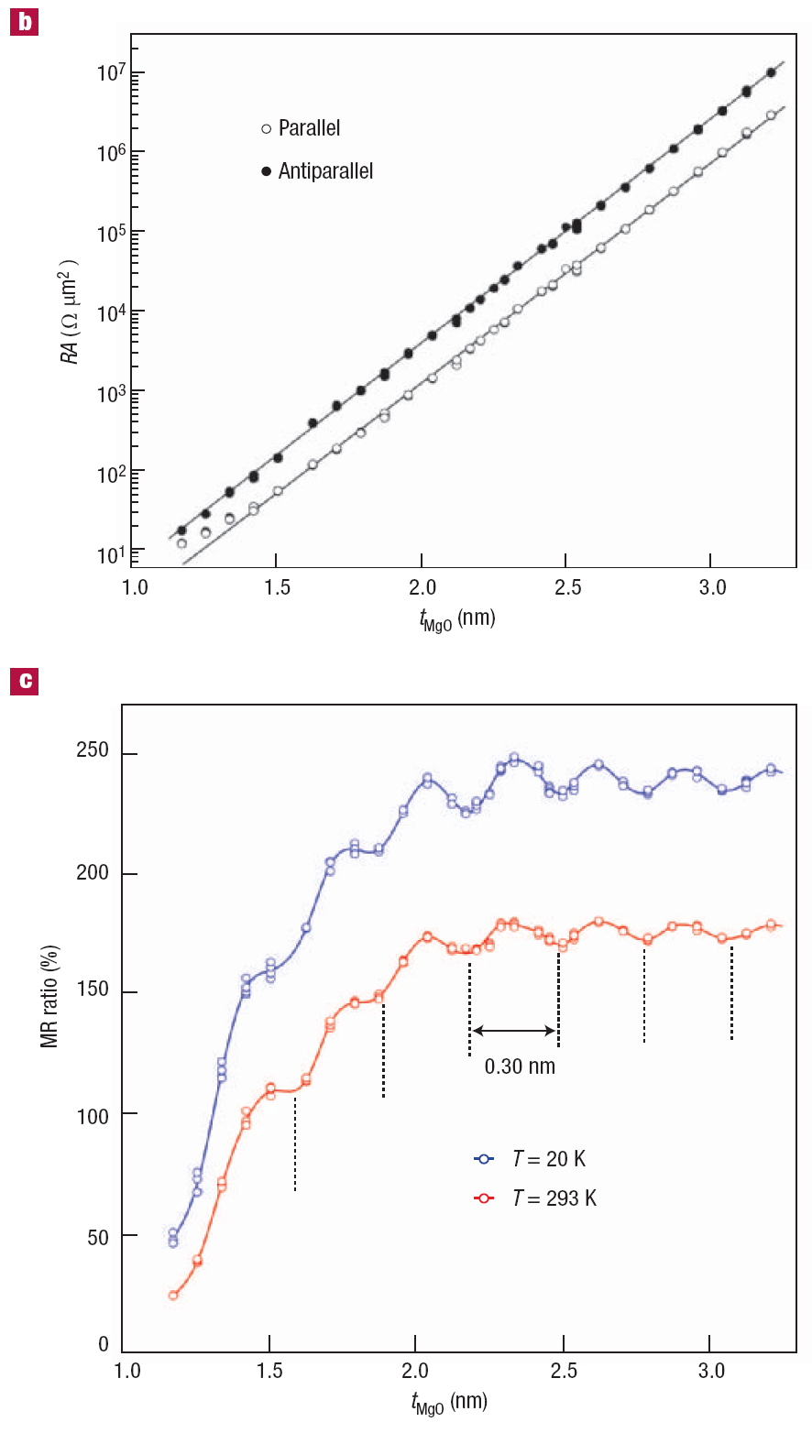
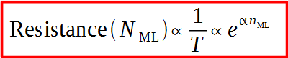
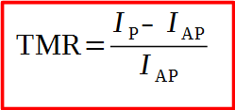
Resistance and TMR
RA (Ωμm²)
Resistance increases exponentially with the thickness with a damping coefficient α
t_{MgO} (nm)
I_{P}
Parallel
MR ratio (%)
I_{AP}
t_{MgO} (nm)
Anti-Parallel
Yuasa et al., Nature Materials 3, 868 (2004)

Slide 16
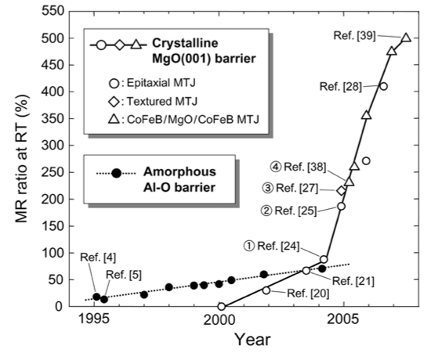
S. Yuasa and D.D. Djayaprawira , J. Phys. D: Appl. Phys. 40, R337 (2007)

Slide 17
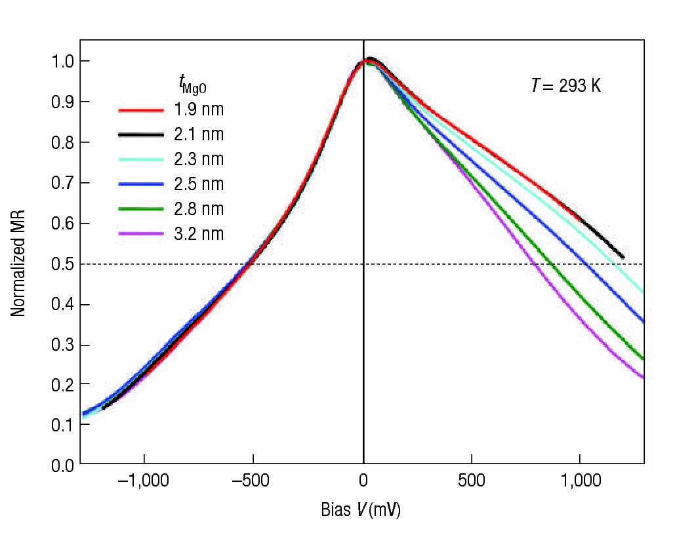
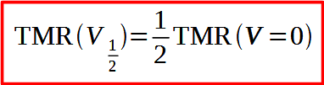
TMR versus bias voltage
Normalized MR
Bias V (mV)
Yuasa et al., Nature Materials 3, 868 (2004)
Can we describe the I-V and TMR-V with ab initio methods?
What is the origin of the decay of the TMR with increasing bias?

Slide 18
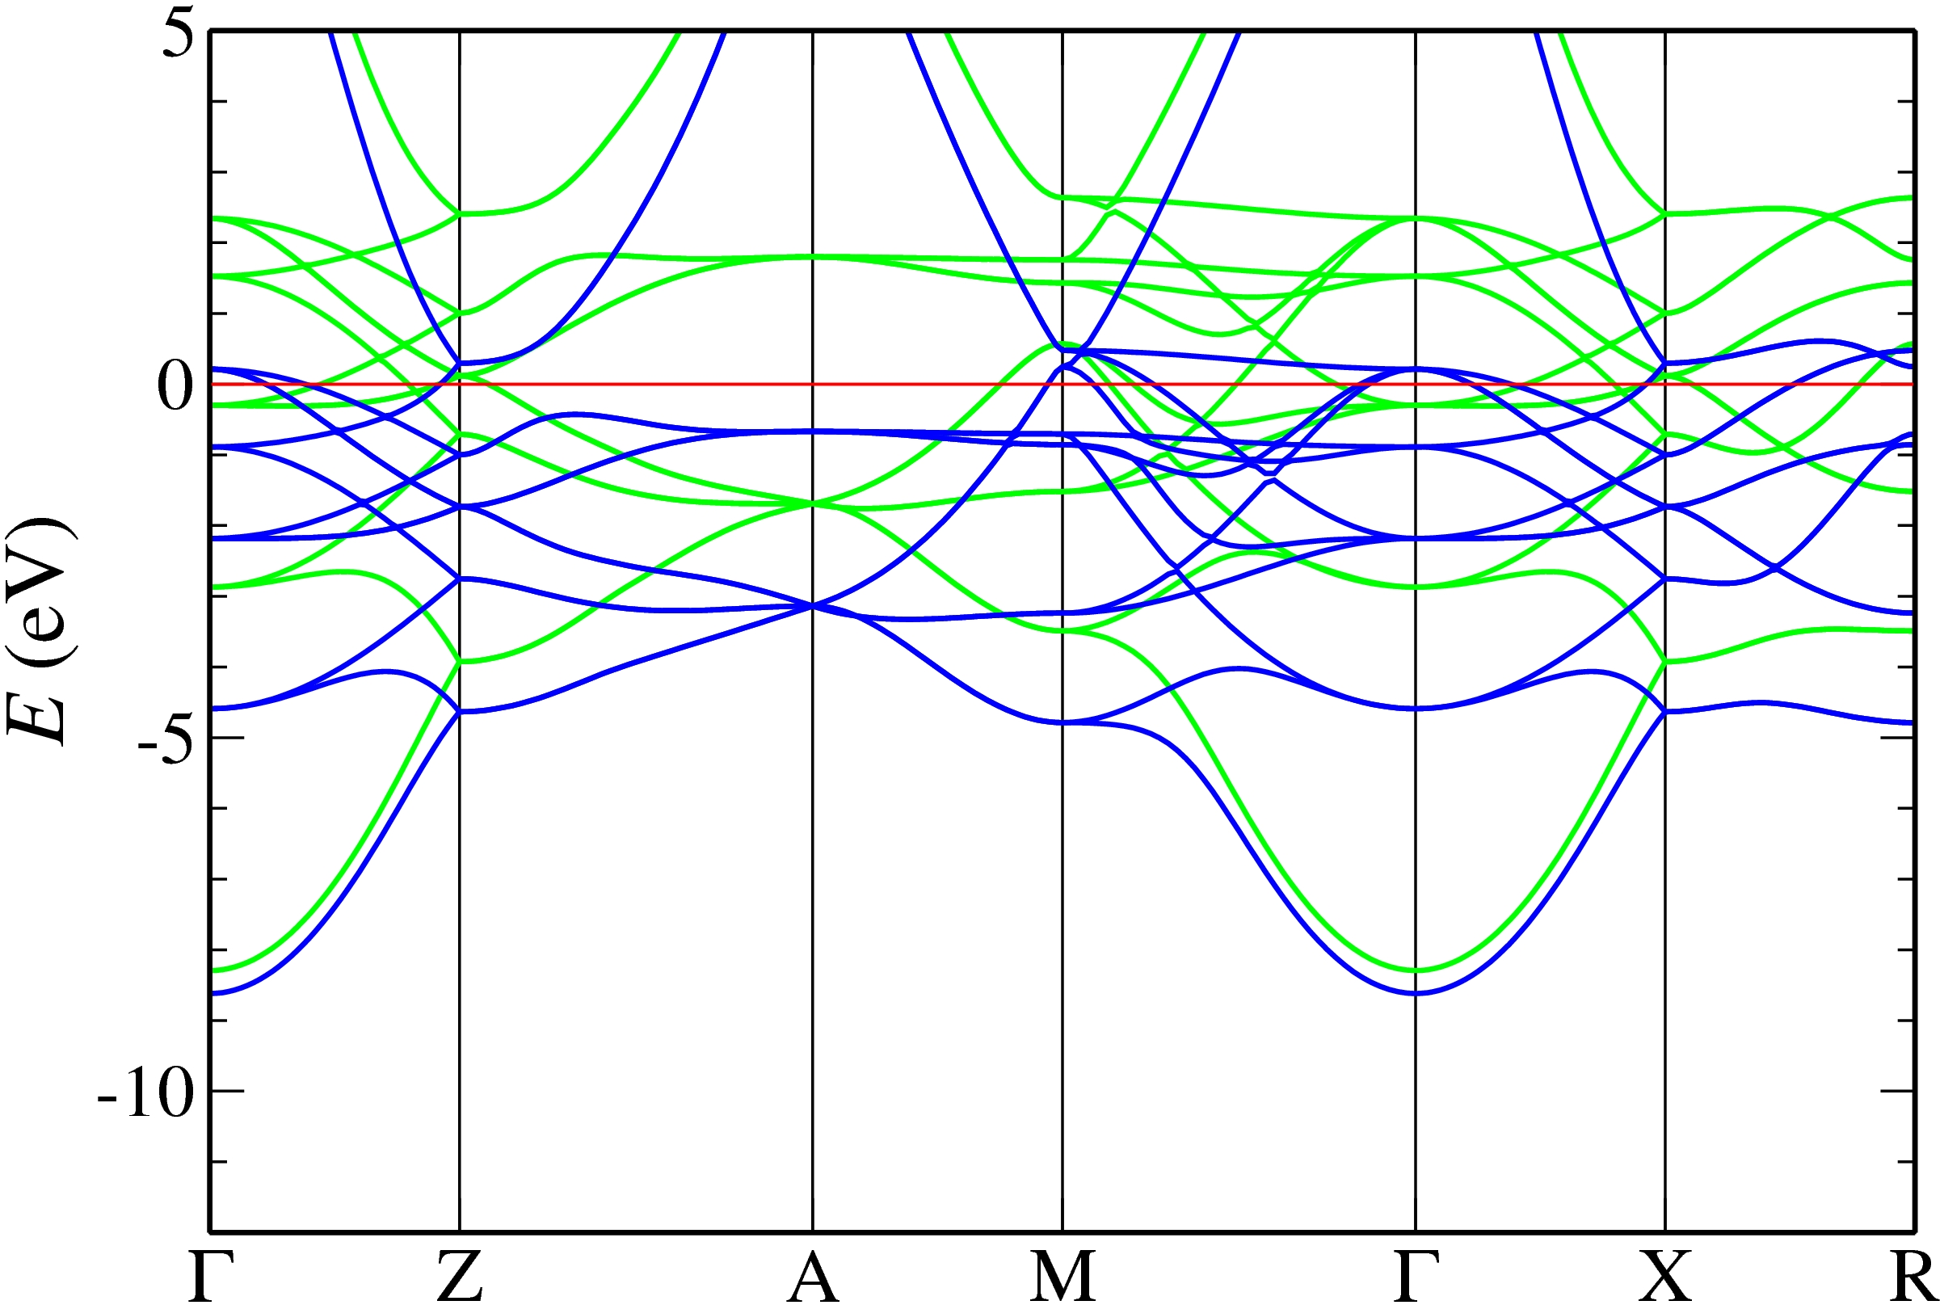
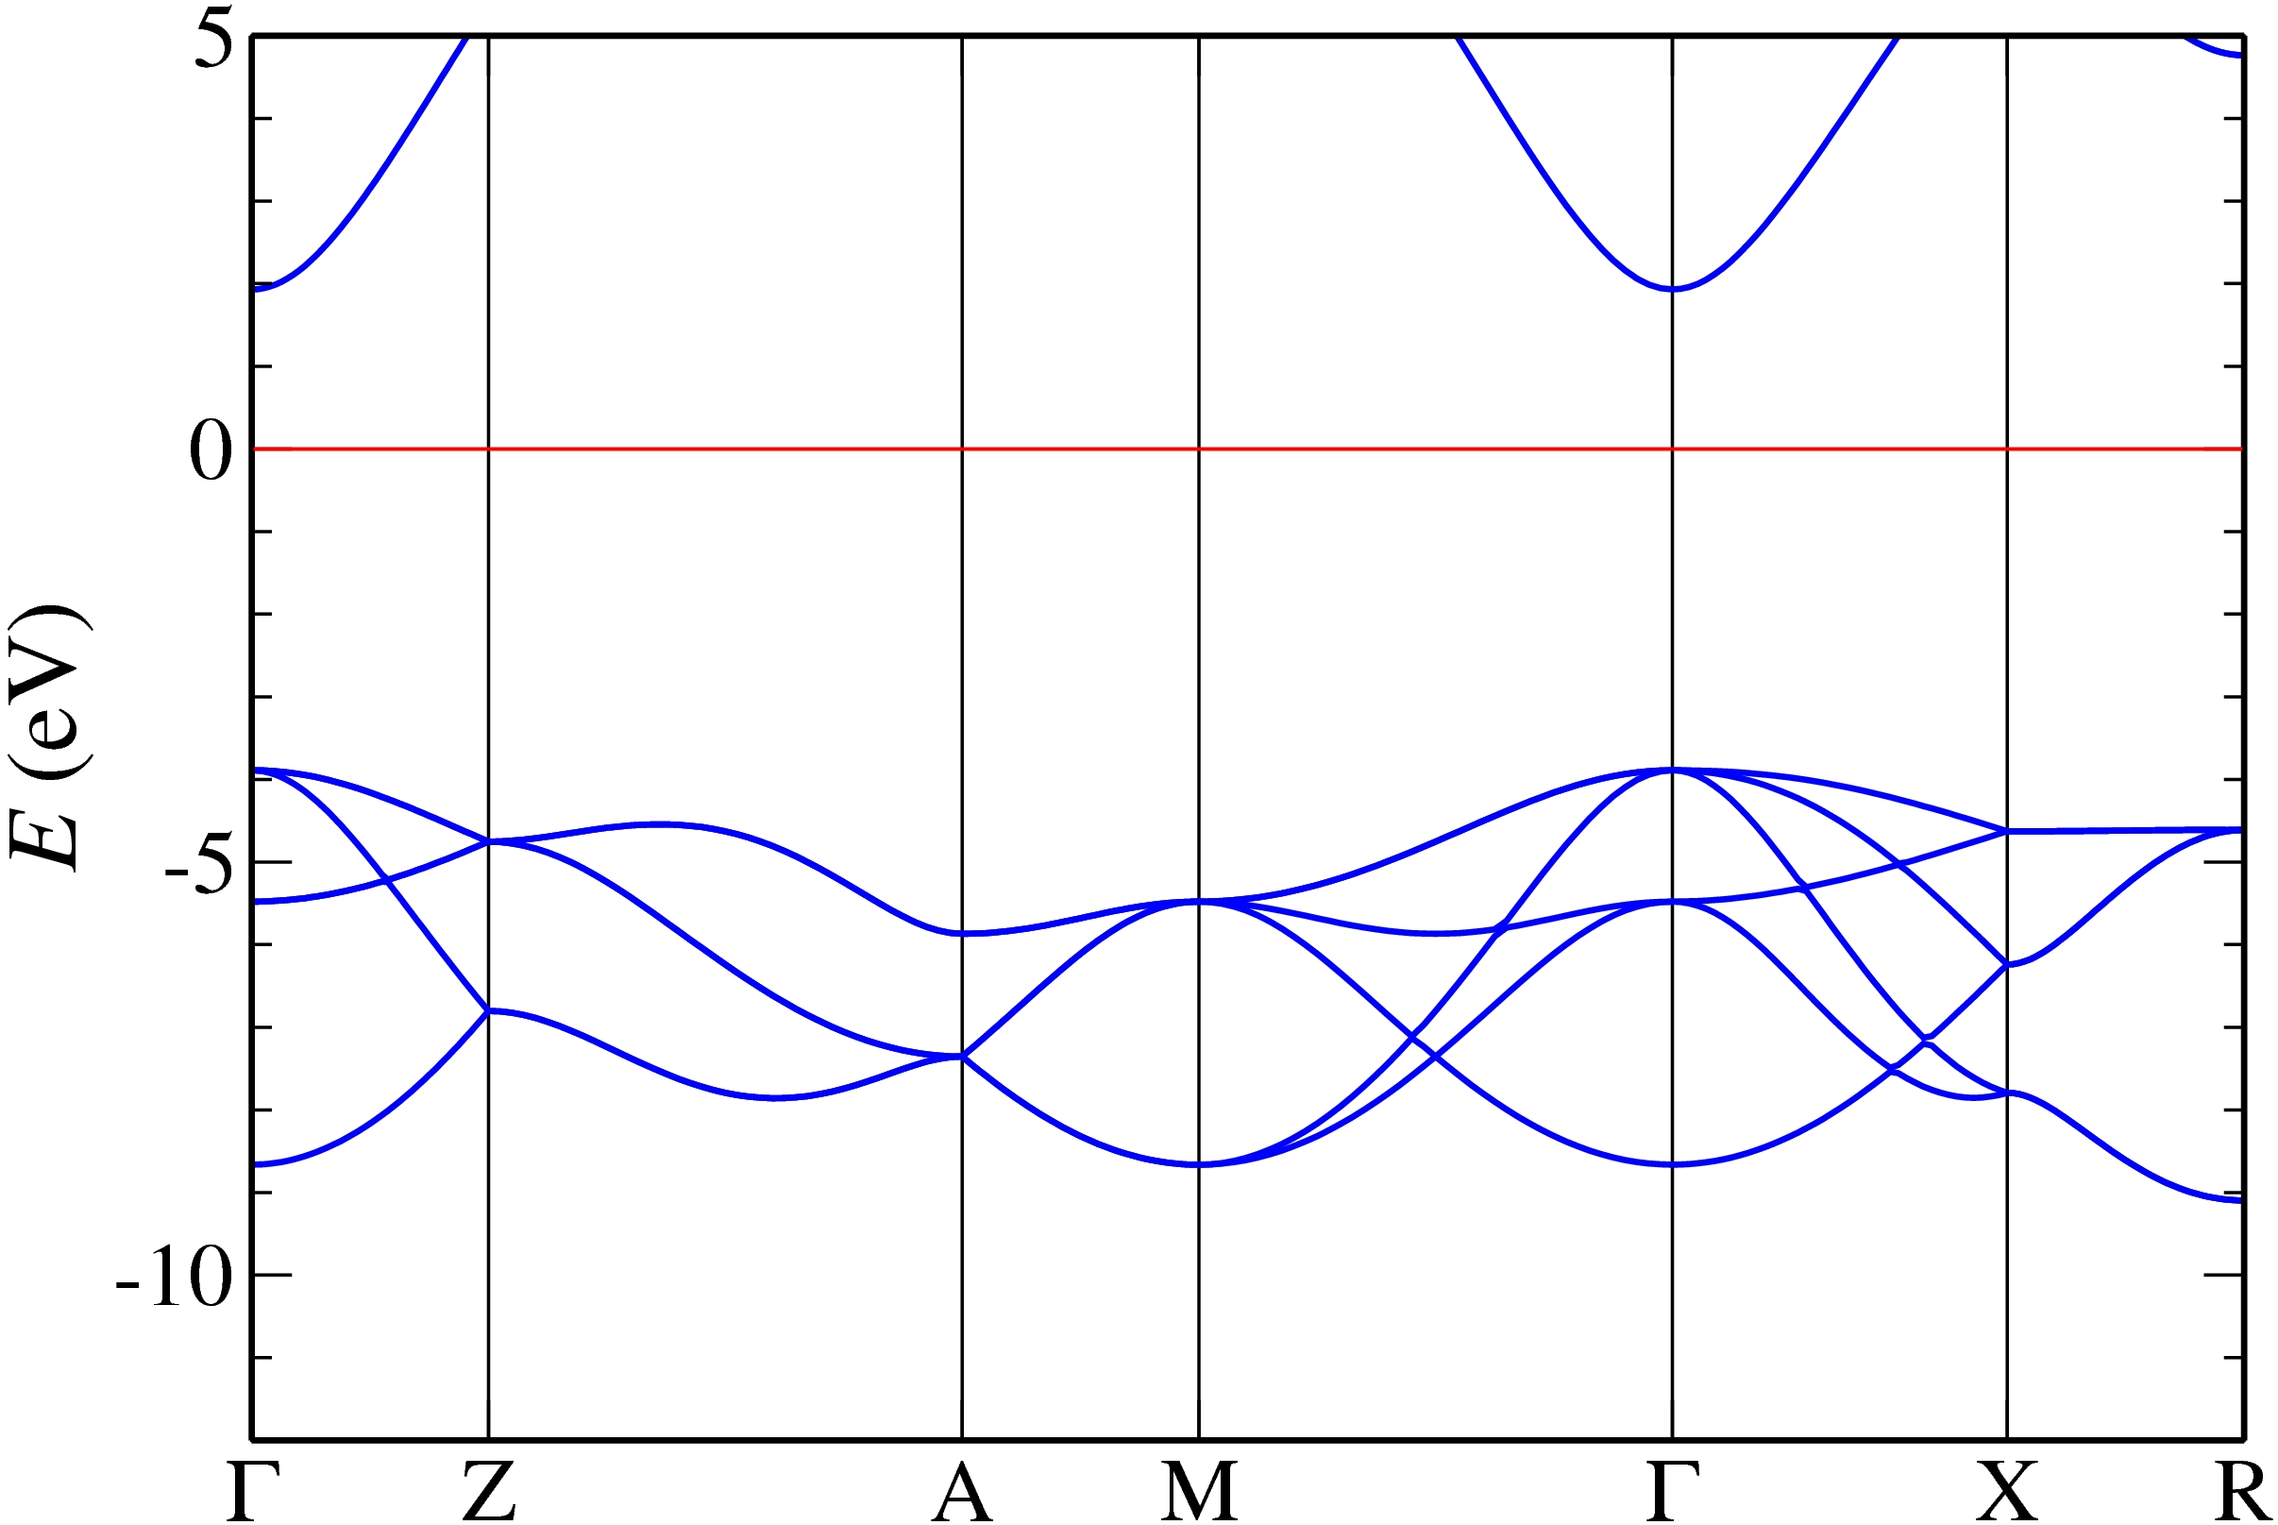
Band structures
Fe
MgO

Slide 19
Why Large TMR?
W. H. Butler et al., PRB. 63, 054416 (2001)
A. V. Khvalkovskiy et al., J. Phys. D: Appl. Phys. 46, 074001(2013)
Notes:
19

Slide 20
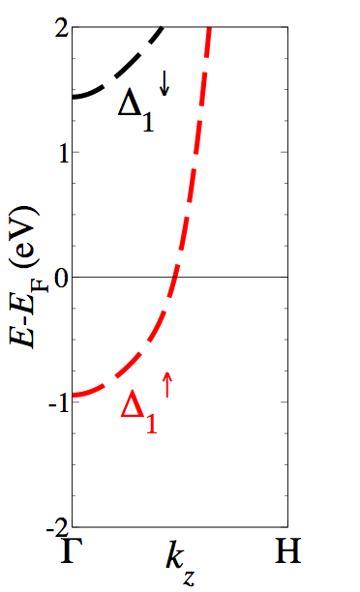
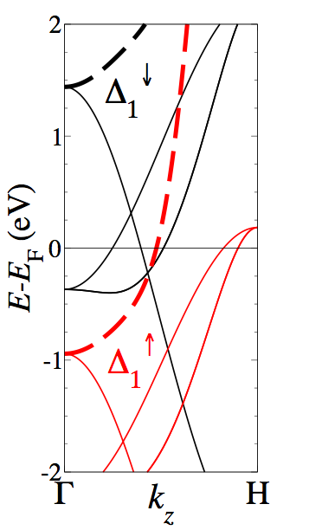
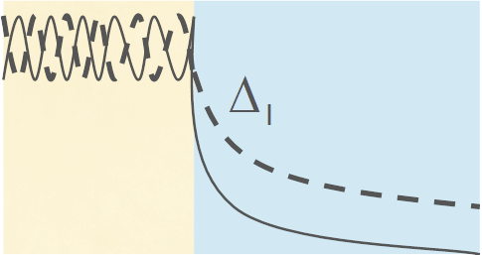
Why the large TMR? Fe/MgO is a “half metal”
Fe
MgO
W.H. Butler et al., PRB 63, 054416 (2001)
Notes:
20

Slide 21
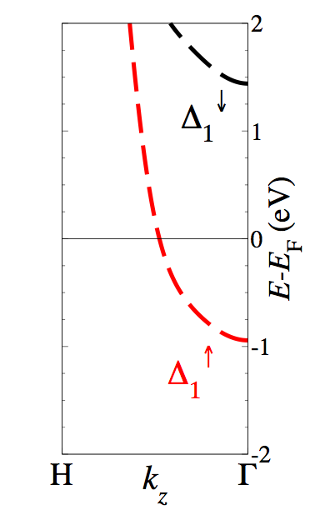
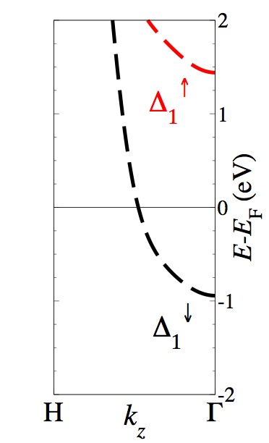
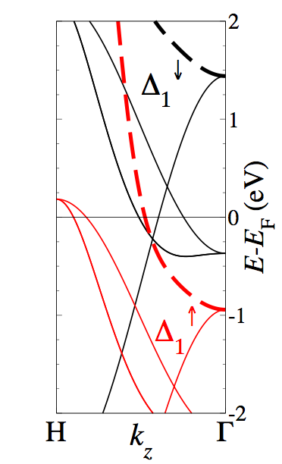
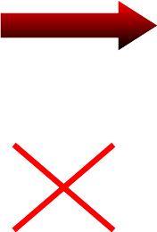

Why the large TMR?
FM1
FM1
MgO
Notes:
21
Mention: high spin-polarization of current leads to large MR

Slide 22
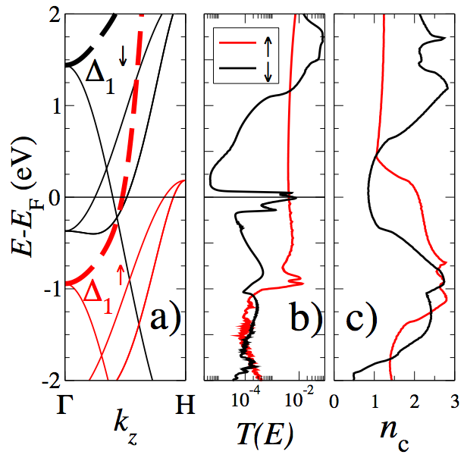


Zero-bias transmission
2
states in the electrodes
1
E-E_{F} (eV)
0
-1
interface states
-2

Slide 23
Comparison to experiment
4 MgO layers: TMR = 1700 %
for thicker junctions (16-24 MgO layers) : TMR = 30000 - 40000 %
experiment : TMR < 1100 %
Notes:
23

Slide 24
Bias dependence

Slide 25
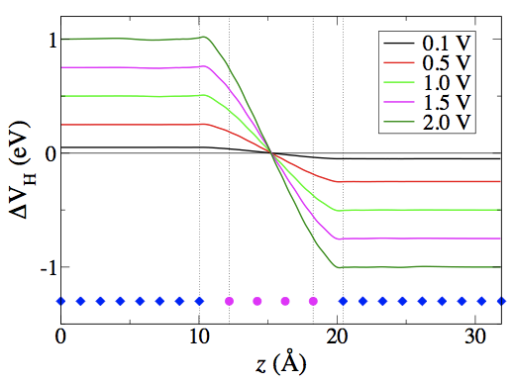
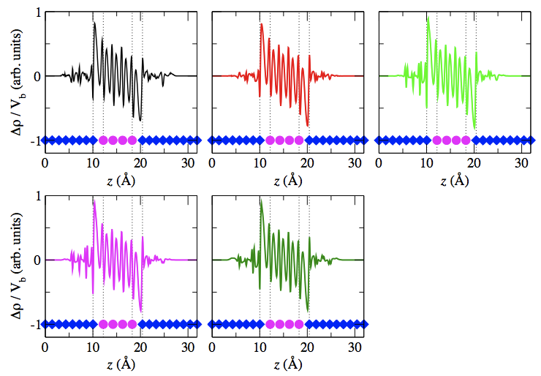
Charging and potential drop

Slide 26
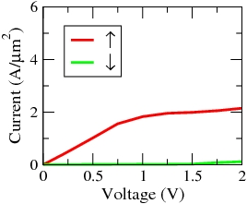
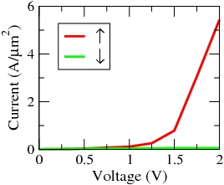
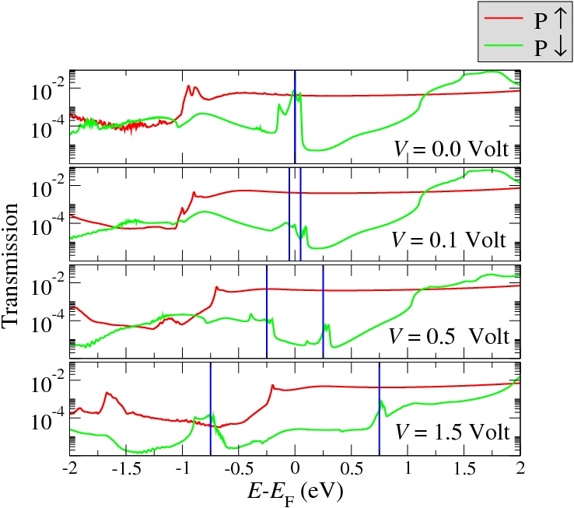
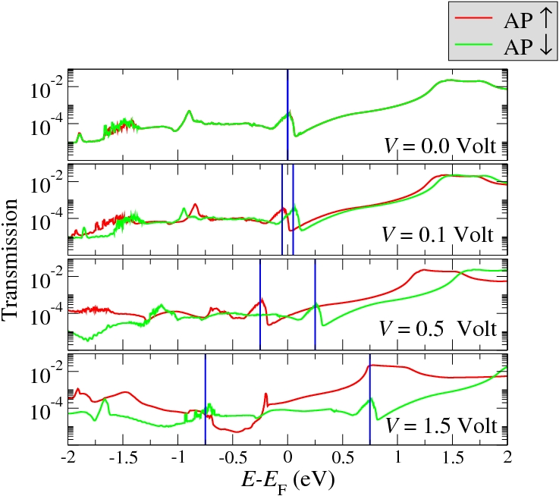
Current versus voltage
Parallel
Anti-Parallel
Notes:
26

Slide 27
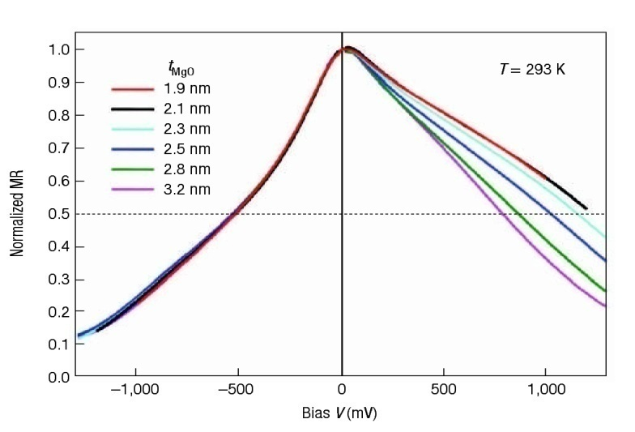
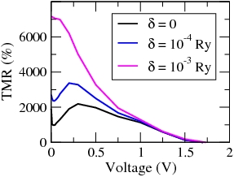
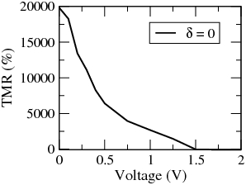
Why does TMR decay with bias?
4 MgO layers
8 MgO layers
Experiment
Bias V (mV)
Rungger et al., PRB 79, 094414 (2009)
Rungger et al., JMMM 316, 481 (2007)
Yuasa et al., Nature Materials 3, 868 (2004)
For larger bias Δ₁ states are found also in the minority spins, so that the minority current increases
TMR decreases
Notes:
27
Say: investigated by a number of groups, we all came to same conclusions

Slide 28
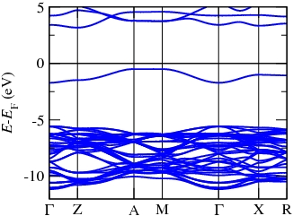
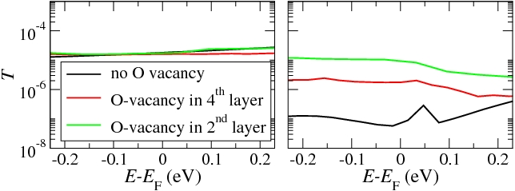
Oxygen vacancies
MgO band structure with Oxygen vacancy (1/16)
Defect band with band center about 1 eV below the Fe Fermi energy
0-bias transmission for an 8 ML junction, and for a vacancy in different positions
parallel
anti-parallel
For P alignment the transmission is almost not affected
For AP alignment the transmission increases as the vacancy gets closer to the interface. The reason is an increase of the Δ₁ DOS in the minority spin

Slide 29
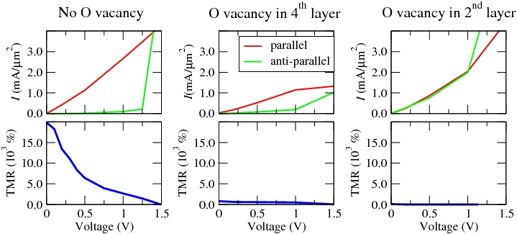
TMR versus bias
I. Rungger et al., to appear in book chapter (Spin Transfer Torque Memory) in “Nanomagnetic and Spintronic Devices for Energy Efficient Memory and Computing, Wiley.
Structure of the interface is key
Theory can match quantitatively experiment if disorder/defects are taken into account
Notes:
29
SAY: quantitative predictions if experimental structures are used
Say: how can we know the right structure if everythiong is buried?
AP current is strongly enhanced by oxygen vacancies, especially if they are close to the interface, leading to a reduction of the TMR
These type of defects close to the Fe/MgO interface lead to a depolarization of the Δ1 DOS, thereby reducing the TMR
High quality interfaces are needed in order to obtain high TMR values
Theory can match quantitatively experiment if disorder is taken into account

Slide 30
Spin Transfer Torque
Notes:
30

Slide 31
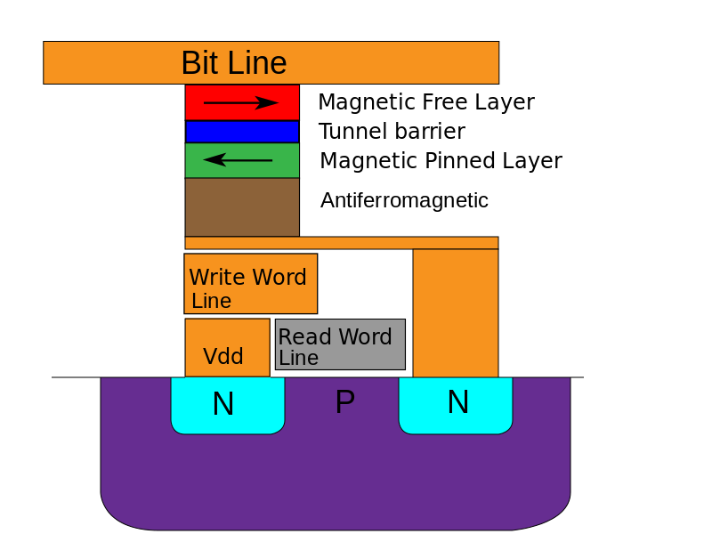
MRAM (magnetic random access memories)
How can we switch the free layer?
Current induced spin transfer torque

Slide 32
Spin Transfer Torque
Notes:
Mention
that out of plane torque is non zero also at 0 bias

Slide 33
Title
Spin Transfer Torque
Conservation of momentum leads to spin transfer torque

Slide 34
Spin Transfer Torque

Slide 35
DFT with non-collinear spins

Slide 36
Spin Transfer Torque
SubSystem 1 (SS₁)
SubSystem 2 (SS₁)

Slide 37
STT for Fe/MgO/Fe
z
x
V=0.5 Volt

Slide 38
Spin Transfer Torque on right Fe electrode
In plane torque
Out of plane torque

Slide 39
Spin Transfer Torque

Slide 40
Spin Transfer Torque
Landau-Lifschitz-Gilbert equation

Slide 41
Spin Transfer Torque
P to AP switch (V=0.3 Volt)
AP to P switch (V=-0.4 Volt)

Slide 42
Towards industrial needs…
Write error rate is critical parameter

Slide 43
Correlated linear response transport in nanostructures
Notes:
43

Slide 44
Correlated impurities
The algorithm
N. S. Wingreen and Y. Meir, PRB 49, 11040 (1994)
Y. Meir and N. S. Wingreen, PRL 68, 2512 (1992)
Can be described within NEGF by adding an additional self-energy

Slide 45
Kondo effect: experiments
The algorithm
Experiment
G. D. Scott and D. Natelson, ACS Nano 4, 3560 (2010)

Slide 46
How to get the many body self-energy?
The theoretical model
Correlated atom
D. Jacob et al., PRL 103, 016803 (2009)

Slide 47
How to get the many body self-energy?
The theoretical model
Correlated atom
Project full system on correlated atom
0
d
d
Impurity solver
Impurity solvers:
Non-crossing approximation
One-crossing approximation
FLEX
Continuous time quantum Monte Carlo
D. Jacob et al., PRL 103, 016803 (2009)

Slide 48
Current
The theoretical model
Meir-Wingreen...

Slide 49
Neglect incoherent contributions
The theoretical model
Landauer...

Slide 50
Kondo effect
The algorithm
DFT based calculations
D. Jacob et al., PRL 103, 016803 (2009)

Slide 51
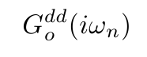
Continuous time quantum Monte Carlo
The theoretical model
Continuous-time
quantum Monte Carlo
(interaction/hybridization expansion)
E. Gull, A. J. Millis, A. I. Lichtenstein, A. N. Rubtsov, M. Troyer, P. Werner, Rev. Mod. Phys. 83, 349 (2011)
Analytic continuation
Stochastic optimization
A.S. Mishchenko et al., PRB
62, 6317 (2000)

Slide 52
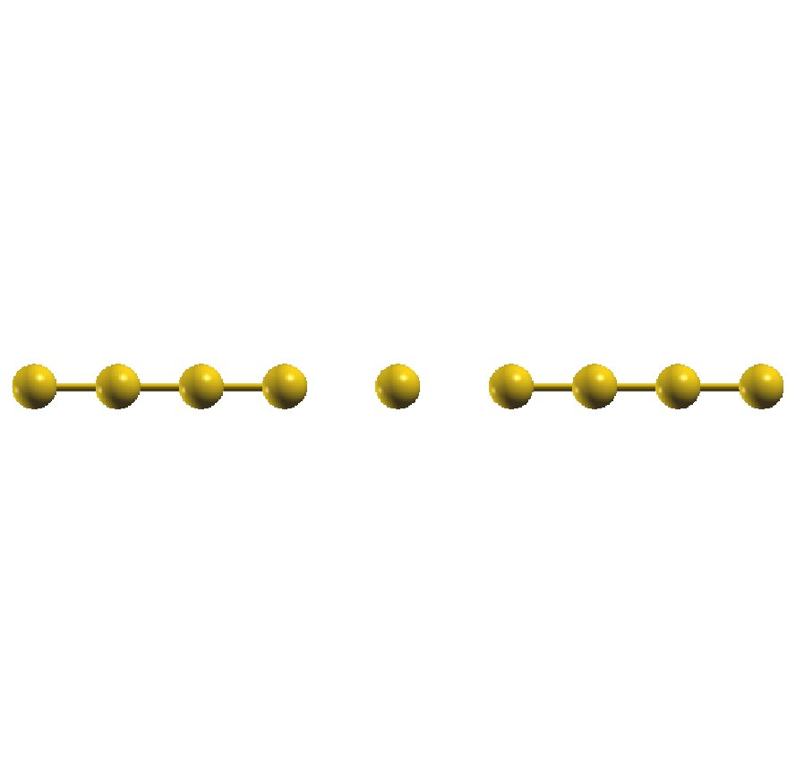
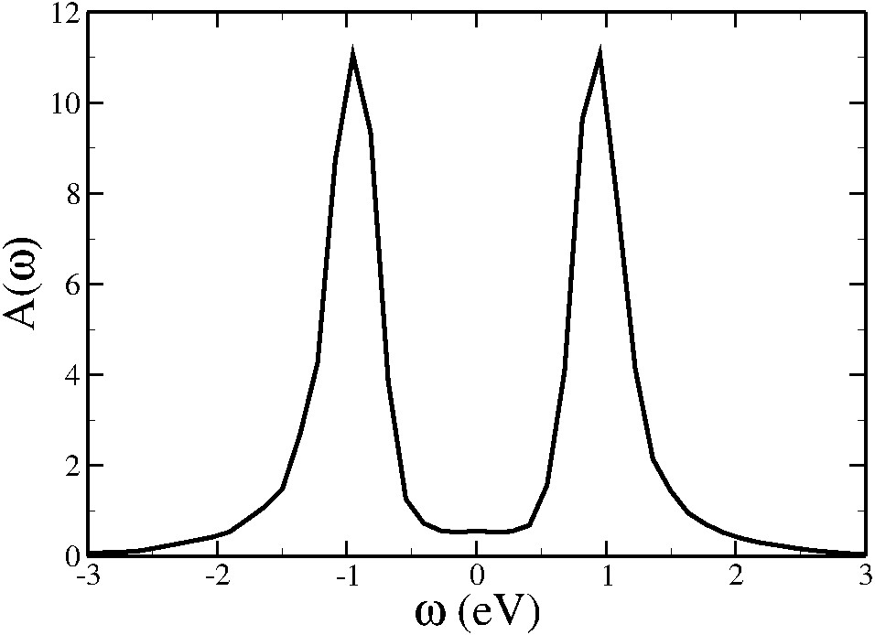
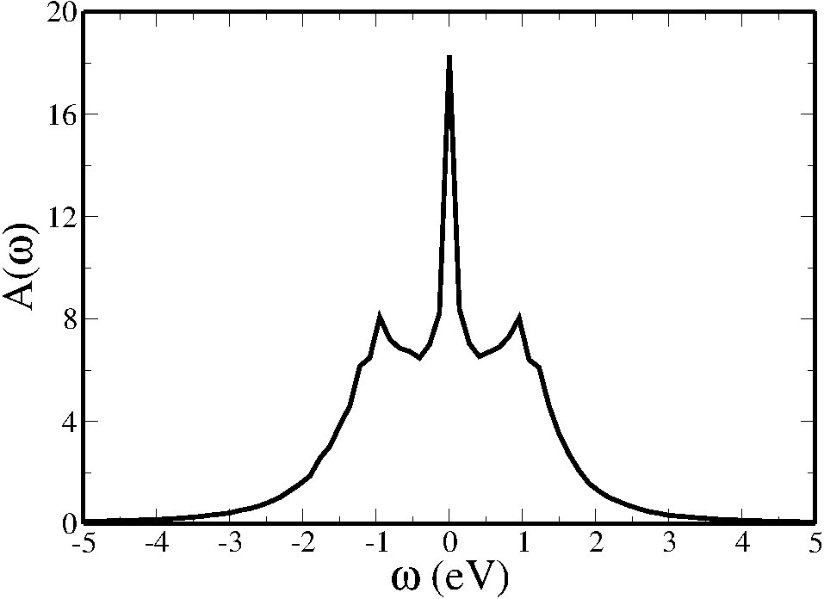
Example system
In DFT: Au chain test sytem
The algorithm
U= 2 eV, T= 50 K
d
d = 4.2 Ang
d = 3.8 Ang

Slide 53
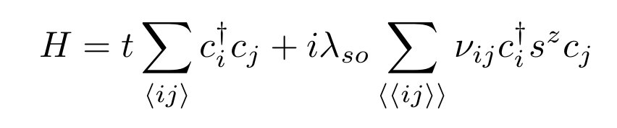

2D Topological insulators – Kane&Mele model
(convetion: energy in units of t, t = 1 in this talk)
.
C.L. Kane and E.J. Mele, Phys. Rev. Lett., 95, 146802 (2005)
Notes:
5353

Slide 54


2D Topological insulators – Kane&Mele model
T =2 (1 for each edge)
k
.
C.L. Kane and E.J. Mele, Phys. Rev. Lett., 95, 146802 (2005)
Notes:
5454

Slide 55

Topologically protected states: 1D scattering
t
r
No back scattering
Notes:
55
Mention:
->Overall the spin-polarization is 0, however due to spin-orbit interaction the band structure is different for up- and down-spins ()
-> We are going to show experiments where this has indeed been shown for step-like potentials, and then our ab initio calculations for that
->The two spin channels are independent:no back scattering possible, therefore transmission is perfect

Slide 56

2D Topological insulators – Kane&Mele model
Magnetic impurity on the edge
- Local moment
- Broken time-reversal symmetry
- Conductance can drop
.
Notes:
5656

Slide 57


Kane&Mele model: correlated impurity
Correlated
substitutional impurity
Transport direction
Notes:
5757

Slide 58

Kane&Mele model: correlated impurity
The algorithm

Slide 59

No magnetic impurity
Notes:
5959

Slide 60






Coherent transmission
Coherent transmission
Coherent transmission
High temperature regime
Local moment regime
Kondo regime
T=0.5
T=0.2
T=0.01
In the Kondo regime:
No impurity induced scattering within linear response
Notes:
60
yyy: what is our value of U (4 ?)?
Yyy: remove self-energy curves? Mayve just mention that self-energy vanishes

Slide 61

Kondo screening
J. Maciejko et al. Phys. Rev. Lett. 102, 256803 (2009)
F. Goth et al., Phys. Rev. B 88, 075110 (2013)
F.M. Hu et al., Phys. Rev. B 88, 045106 (2013)

